Slide 1
Lake Clear
Victor Castro
Eastern Region
Ontario Ministry of the Environment
and Climate Change
June 5, 2018

Slide 2
Summary of Presentation
Overview of Ontario lakes and water quality conditions
Role of phosphorus and dissolved oxygen
Lake Clear conditions
Sources of phosphorus to Lake Clear
Highly Sensitive designation in Official Plan

Slide 4
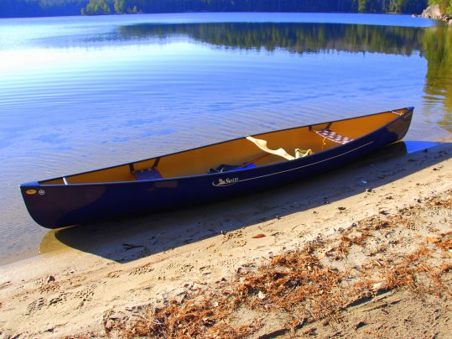
The economic value of clean water in Ontario
~2 million adult anglers per year
$1.2 billion in fishing gear, boats, etc.
$1.7 billion in activities related to fishing
$1 billion annually on recreational boating
commercial fisheries (~$42.5 million)
water-related tourism (~$5.5 billion)
Photo: Gregory Brand
(Lakeshore Capacity Assessment Handbook- May 2010)
Notes:
Water quality affects environmental, recreational, economic and property values
Today, lake-based recreation and tourism form an important part of rural and provincial communities, particularly in communities that were historically-reliant on forestry or mining
Based on numbers from the early-1990s, at least 2 million adult anglers are licensed to fish in the Province each year
More than 2 billion dollars is spent annually in fishing and fishing-related activities, with an additional 1 billion Canadian dollars spent on other recreational activities related to recreational boating
Commercial fisheries in the Great Lakes and Inland lakes in Ontario general an approximate $42.5 million dollars annually in market sales and taxes
And finally, other forms of water-related recreation and tourism which, in some parts of the Province, such as the NW, is dominated by Americans, an additional $5.5 billion dollars Canadian can be generated annually
Therefore, the combined value of maintaining clean water in Ontario is about $9 billion a year.

Slide 5
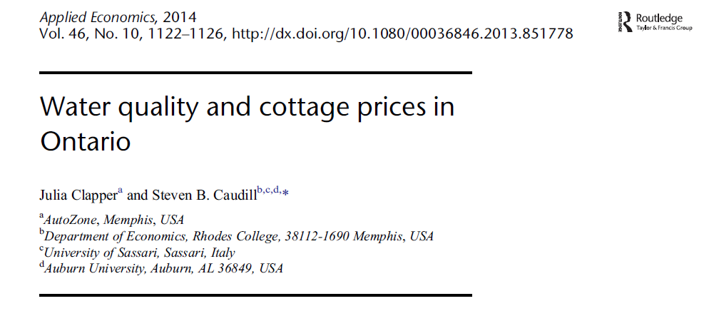
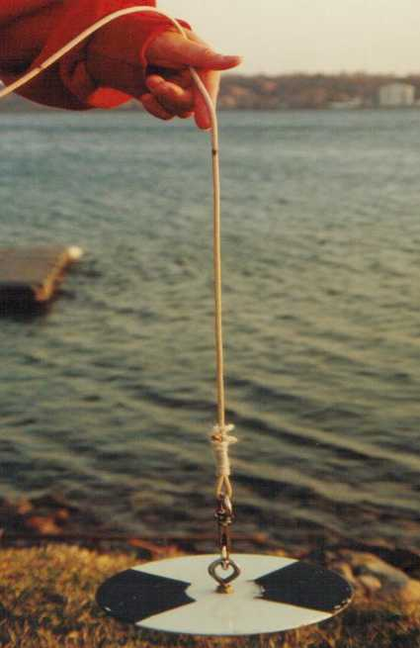
Prices rise by ~6% for every metre increase in water clarity
5

Slide 6
Threats to water quality of inland lakes
Acid rain
Climate change
Contaminants
Lake
Invasive species
STP’s, Farming
Practices, Urban
Shoreline
development
Photo: Gregory Brand
Notes:
-There are a number of threats, presently, to the water quality of inland lakes in the Province of Ontario (and many of these threats are widespread, and not restricted to Ontario).
Some of these stresses act regionally, like the deposition of strong acids or major contaminants, such as Hg from the burning of fossil fuels, or long-term changes in climate
Others may be more local in effect, such as the introduction of invasive species to lakes – exotics such as the zebra mussel that has invaded the Great Lakes, and many inland lakes through North America
Understanding the relative impacts of these stressors on lake water quality is complicated as they do not act in isolation
For example, most lakes are exposed to more than one stress, such as acid precipitation and shoreline development – and some lakes are exposed to multiple stressors
Today, we will focus on the impact of shoreline development on lake water quality
In many of Ontario’s more remote regions, which can be several hundred miles north of major industrial centres, this may represent the most significant threat to water quality, although these lakes are certainly not immune from other threats
Development can be defined as an activity which, through the creation of additional units, or change in land or water use, adversely affects water quality and the aquatic habitat

Slide 7
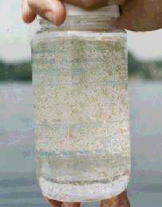
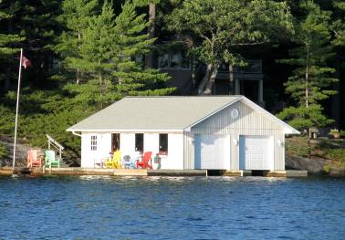
Phosphorus- the link
Phosphorus
Shoreline development
Nutrient enrichment is the primary water quality concern in most of Ontario’s inland lakes
Algae blooms
Photo: Kathryn Hargan
Notes:
As the nutrient most often limiting primary production in Canadian Shield lakes, excess phosphorus can lead to the production of algal blooms
The phosphorus in sewage waste associated with shoreline development can pose a serious threat to water quality
The concentrations of phosphorus in waste waters are ~200-300 times higher than the [P] needed to stimulate algal growth in lakes
The worst-case scenario for impacts of shoreline development on water quality are images like these...

Slide 8
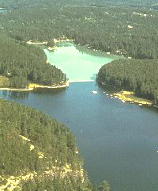
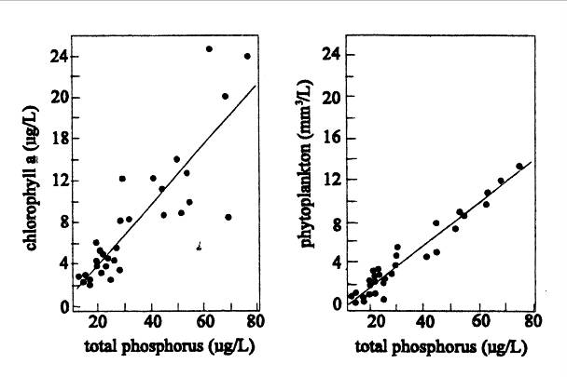
The importance of phosphorus –> algae
n = 31

Slide 9
Lake Clear
Lake Clear – surface area of 1730 ha
Maximum depth of 43 metres
Total watershed area 7705 ha
Flushing rate 0.18 times/year
Turnover time 3 to 5 years
Lies in the Bonnechere River drainage basin
Significant development numbers on Lake Clear

Slide 10
Lake Clear Watershed

Slide 11
Lake Clear
Managed by MNRF as a naturally reproducing lake trout lake
Also contains healthy population of walleye
Lake Trout lakes represent only 1% of all lakes in Ontario, but these represent 25% of the world’s lake trout resource.
Lake trout are vulnerable to the impacts of human activities and require special protection
Climate change poses a significant new threat to lake trout lakes

Slide 12
SOURCES OF PHOSPHORUS
Found naturally in all aquatic ecosystems
Surface runoff
Atmospheric deposition
Sediments of lakes
Upstream lakes
Agricultural land uses
Urban inputs
Shoreline development

Slide 13
DEGRADATION OF LAKE QUALITY
Land use activities and disturbance on watershed results in increased levels of phosphorus.
Phosphorus promotes algae and aquatic plant growth.
In extreme cases results in algae blooms.
Decomposition of organic material consumes oxygen in the bottom waters.
Reduces amount of dissolved oxygen for species such as Lake Trout.

Slide 14
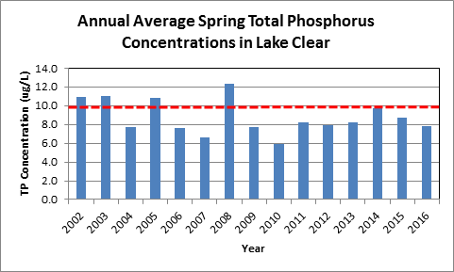

Slide 15
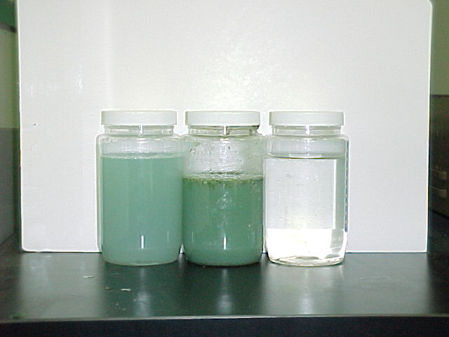

Slide 16
Dissolved Oxygen
Dissolved oxygen concentrations measured through water column
Profiles going back 30 plus years
Deep water oxygen consistently low
Release sediment bound phosphorus
Lake Trout Lakes – Provincial Water Quality Objective is 7 mg/L dissolved oxygen
If < 7 mg/L lake is considered highly sensitive or at-capacity

Slide 17
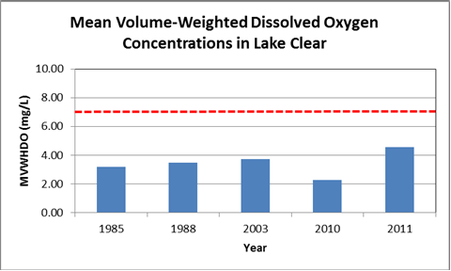

Slide 18
Summary
Phosphorus concentrations in Lake Clear are moderate and stable.
Dissolved oxygen concentrations are low (fail to meet Provincial Water Quality Objective).
Highly sensitive designation – goal is to reduce phosphorus loadings to lake and improve oxygen concentrations to protect lake trout habitat.
Generally, this means a prohibition on new lots within 300 metres of lake.

Slide 19
Summary
Any development or redevelopment should be done in a manner that improves existing conditions
Climate change poses additional stressor that needs to be factored into management decisions.

